Slide 1
Introduction
Background information about the data set
The data set was downloaded from fueleconomy.gov.
The data is the result of the vehicle testing by the Environmental Protection Agency and by vehicle manufacturers.
All vehicle models were the year 2017.
Research Question = Estimating the miles per gallon of a car by the predictor variables.
Which predictors variables will be included in the regression model?

Slide 2
Variable Selection
There are 1085 observations of 13 variables.
Response Variable: Combined miles per gallon
Quantitative Predictor Variables
Engine Displacement
Number of Cylinders (3, 4, 5, 6, 8, and 12 cylinders)
Number of Gears (1, 4, 5, 6, 7, 8, 9 and 10 gears)
Green House Gas Rating
Smog Rating
Carbon-Dioxide Emissions
Qualitative Predictor Variables
Country of Manufacture (Germany, Italy, Japan, Korea, Sweden, United Kingdom and USA)
Transmission Type (Automatic or Manual)
Drive Description (2-wheel drive, 4-wheel drive, all-wheel drive, part-time 4-wheel drive)
Fuel Usage Description (diesel, mid-grade, regular and premium)
Carline Class Description (Subcompact, Compact, Large, Midsize, Pick-Up Truck, and SUV)
Oil Viscosity (0W-20, 0W-30, 0W-40, 5W-20, 5W-30, 5W-40 and 10-60)
Interactions
Number of Cylinders*Engine Displacement
Smog Rating*CO2 Emissions 3. GHG Rating*Smog Rating 4. GHG Rating*CO2 Emissions

Slide 3
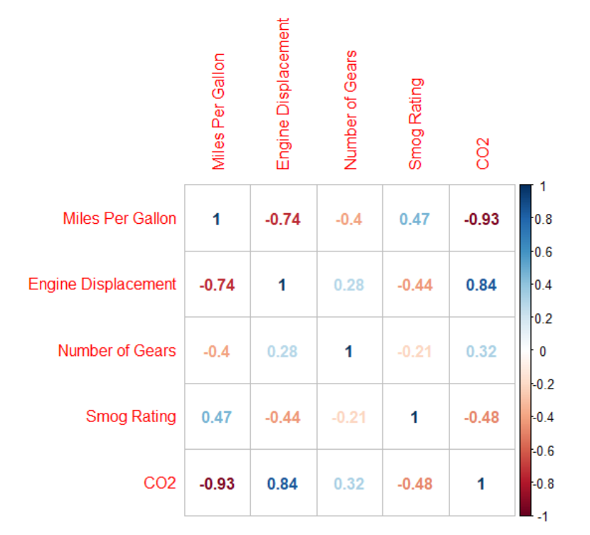
Exploratory Analysis
Correlations between predictor variables
Predictor variables about emissions – greenhouse gas rating, smog rating and CO2 emissions
Greenhouse gas rating and CO2 emissions were strongly negatively correlated (r = - .97).
Predictor variables about the engine – engine displacement, number of gears and number of cylinders
Engine displacement and the number of cylinders in a car were strongly positively correlated (r = .92).
Because of being highly correlated with another predictor variable, greenhouse gas rating and the number of cylinders was dropped.
CO2 emissions and engine displacement are measures that are more precise.
Interactions containing these predictor variables was dropped.
Smog Rating*CO2 Emissions the only interaction.
Correlations between the response variable and the predictor variable

Slide 4
Final Regression Model
Polynomial Regression Model
Combined Miles Per Gallon = CO2 Emissions + Fuel Usage + Engine Displacement + Carline Class + Country of Manufacture + Number of Gears + Oil Viscosity + Drive Description.
R-Squared = 98.29%
The model explains a large portion of the variance in the response variable – combined miles per gallon.
F-Test had a p-value of < 2.2e-16.
The model is a better fit than the intercept-only model
Quantitative Predictor Variables
Engine Displacement
Number of Cylinders
Number of Gears
Green House Gas Rating
Smog Rating
Carbon-Dioxide Emissions
Qualitative Predictor Variables
Country of Manufacture
Transmission Type
Drive Description
Fuel Usage
Carline Class
Oil Viscosity
Interactions
Interactions
Number of Cylinders*Engine Displacement
Smog Rating*CO2 Emissions
GHG Rating*Smog Rating
GHG Rating*CO2 Emissions

Slide 5
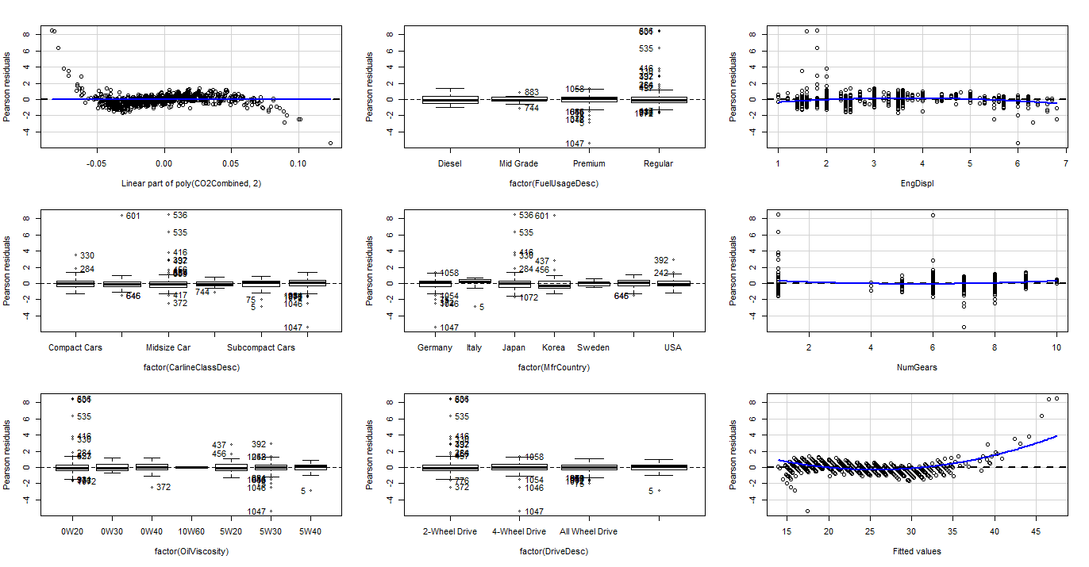
Final Regression Model - Diagnostics
The residual plots for the residuals vs. numeric predictor variables shows that the residuals generally fall within a horizontal band centered at 0.
The same is observed for the residuals vs. fitted values plot.
For the residual plots vs. categorical predictor variable plots, the boxes have a very similar center and spread.

Slide 6
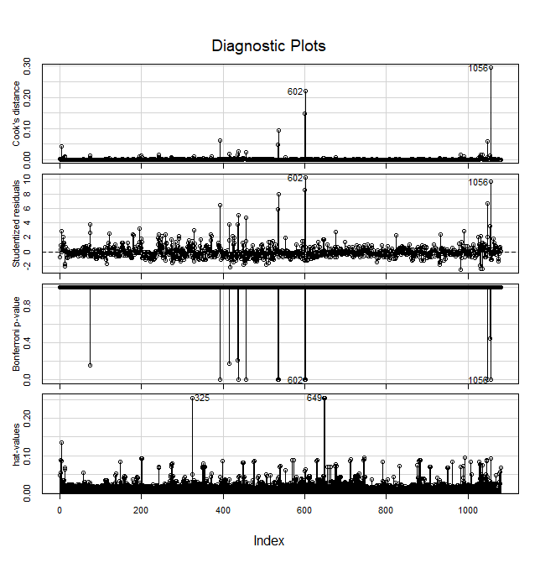
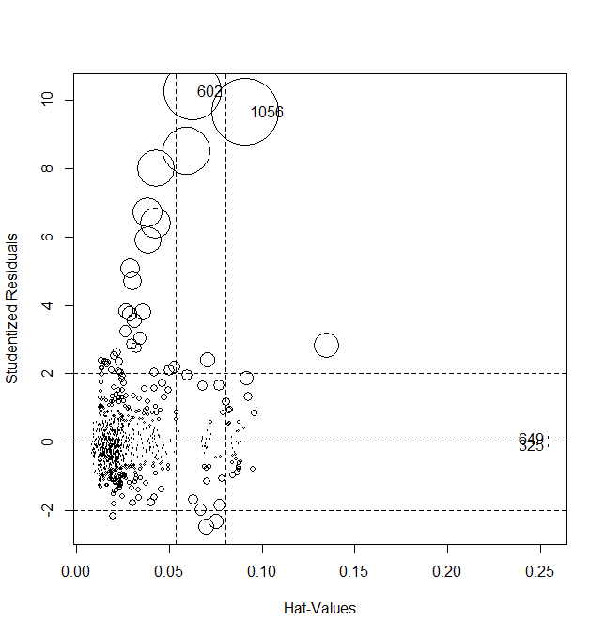
Outliers
Only two outliers were removed – 602 and 1056.
Bonferroni p-values for outlier testing was statistically significant for both.
Both had high influence.

Slide 7
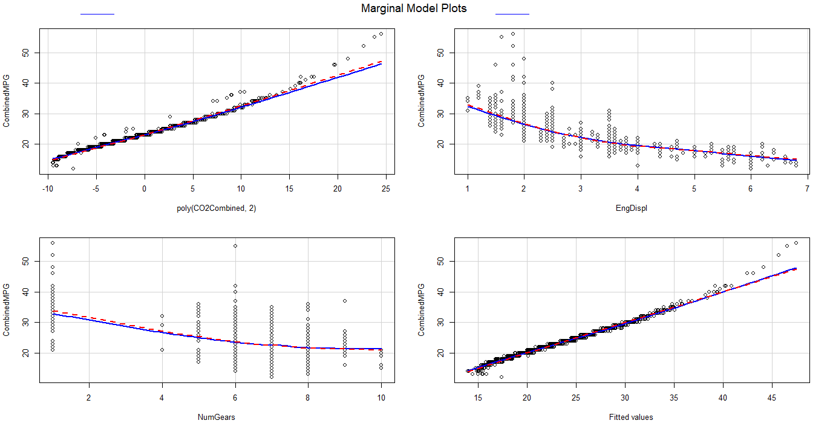
Final Regression Model – Diagnostics, Cont.
In the marginal model plots, the dashed and solid smooth lines are almost matching. This indicates that our model fits the data.

Slide 8
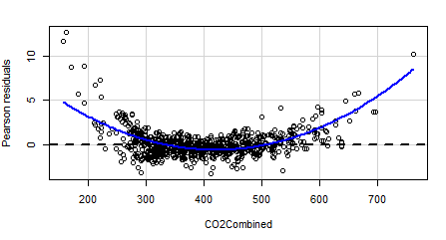
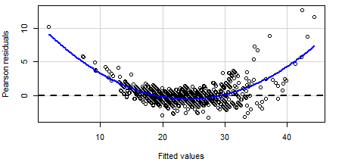
Reasons for a Polynomial Regression Model
In the first regression model, that was in the first-order, the residual plots showed a curved general trend. This indicated a need for a curvilinear regression function.
In the first regression model, from the residual plots, a Tukey’s test for nonadditivity returned a p-value of < 2.2e-16.
This supports the need for a curvilinear regression function.

Slide 9
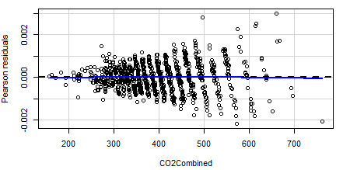
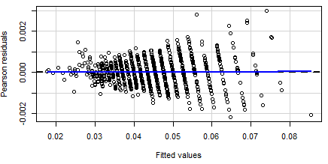
Reasons for a Polynomial Regression Model – cont.
A reciprocal transformation was tried on the response variable to keep the model in the first-order. This transformation was given by a box-cox transformation. The residual plots for this transformed model showed linearity. A studentized Breusch-Pagan test, however, showed that the variances were not constant in this model (p-value < 2.2e-16). So did the residual plots.
The model with the reciprocal transformation in the first-order had a R-squared value at 99.56%. This is only marginally larger than the R-squared value for the polynomial regression model at 98.29%.

Slide 10
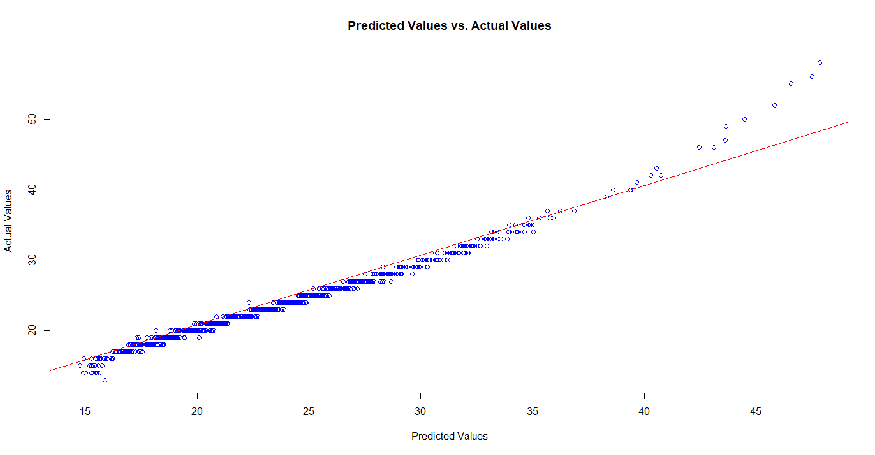
Model Validation
New data was used to test the model. The data used was from the same source, but for the year of 2018.
The polynomial regression model was used to predict the combined miles per gallon of the cars in the 2018 dataset.
Results
The correlation between the predicted values and the actual values was r = .9897.

Slide 11
Conclusions
Limitations
External Validity – Generalizability
The regression model is only generalizable to the class of vehicles that are not plug-in hybrids, electric vehicles or fuel-cell vehicles.
Is the regression model generalizable to older vehicle model years?
Predictions of cars with greater than 35 miles per gallon was not great.
Training of the regression model consisted of only 30 observations of cars with greater than 35 miles per gallon.
The model is not a strong predictor for cars with a combined miles per gallon of over 35.
Internal Validity
Regression model based on predictor variables about the characteristics of the car
May have stronger predictor variables elsewhere
Driver characteristics? Outside conditions?
Suggestions for Future Research
Use data with vehicles that have more than 35 miles per gallon. Incorporate plug-in hybrids, electric vehicles and fuel-cell vehicles.
Test for a predictor variable such as fuel consumption type.

Slide 12
Conclusions
Final Conclusions
The polynomial regression model is useful for estimating vehicles, but with a few caveats.
Cars with a combined miles per gallon less than 35.
Cars that are not of the class of vehicle plug-in hybrids, electric vehicles or fuel-cell vehicles.
Car that are yet to be manufactured.
Based only on the car characteristics.

